Slide 1
Enhanced PT – IBM Maximo
Illustration of “next level of visibility” through PT/NFT
IBM Maximo – Implementation for Ticketing workflows
Notes:
Section breaker slide:
Used for a section heading. You may add a sub heading not exceeding one line also here
Section heading – Arial, bold, 34 font size, should not exceed beyond 1 line
Sub Head – Arial, normal, 20 font size, should not exceed beyond 1 line

Slide 2
IBM Maximo – Comprehensive asset lifecycle and maintenance management
Implementation of Maximo for the Ticketing Platform for a Global leader in minerals and metals processing technology
Platform to provide “automation” for business processes in areas of Asset Mgmnt and Work management…
Platform to be rolled out and used globally across continents for ALL clients and end users of the mining business house…
Platform and automation of business processes using SCCD 7.5 in progress
Determining optimal infrastructure - design / deployment of the platform that should scale in view of phased roll-outs: across Geographies and increasing users
“Enhanced” PT/NFT to assure that platform is built to fulfill the business objectives
Performance evaluations through SDLC – Agile mode in this case

Slide 3




Product Implementation – Performance Evaluation
Product comes with
  Out of box functionalities
  Standard benchmarks on specified hardware under customary conditions
Product implementation involves:
  Formulating your business processes using out of box + “added” conditions + interfaces with existing components…
  “Performance” of the “core” product is a “given” – can not be “tampered” with
  Need to design – build your requirements with (i) “given” from core and (ii) permissible configurations
Customization
Integration
Product
Configuration
Product performance evaluation is about:
  How your business processes – their set-up using core and profile of usage – alters the benchmarks… how can you achieve “max possible”…
  What can be optimal configuration of environment for product in “your” landscape
  What “permissible” settings allow performance gains, how to identify bottlenecks…

Slide 4
Ticketing platform: Service usage and execution perspective
Business processes catered – automated – managed by-through the platform
Inception - Creation
Work - Action
Escalation – consultation
Closure - resolution
Lifecycle of “process”
“Actors” in “process”
CSR
OSC
SPU
RSC
PL
SPC
GD
Search
Task Creation
Resolve
“Activities” in “process”
SR Creation
Incident Creation
Update
Re-open
Escalate
Background “system” chores in “process”
Batch jobs
Cron jobs
Allocation - updates
Underlying Maximo implementation – design of automation . workflow

Slide 5
Performance Evaluation
Test Objective:
Determine design and deployment (w.r.t. performance, NF specifications) in view of business usage(across geographies): guidelines for refining (existing) NFRs and future scalability
Test Strategy:
Ticket process lifecycle is spread across stages and roles in time phased manner and conditional actions. For each business process - the role players and stages are different: Instead of testing the lifecycle of the ticket – the actions being taken by individual roles at variety of stages to be regarded as the system activities
Since the deployments are incremental and there is no concrete visibility on what all services at what all locations – determine the “per unit” design - configuration
Test design:
Point actions on static/pre-available “infant - adult process” at each stage by roles at that stage to take the “process element” to possible next stage(s) – each by different set of user ids, requests etc
Baseline → Stretch → Horizontal & vertical scaling
Inception - Creation
Work - Action
Escalation – consultation
Closure - resolution
Test design
CSR
RSC
OSC
SR, Task Creation
Escalate, Re-open
Task, Incident creation, Resolve, Close

Slide 6
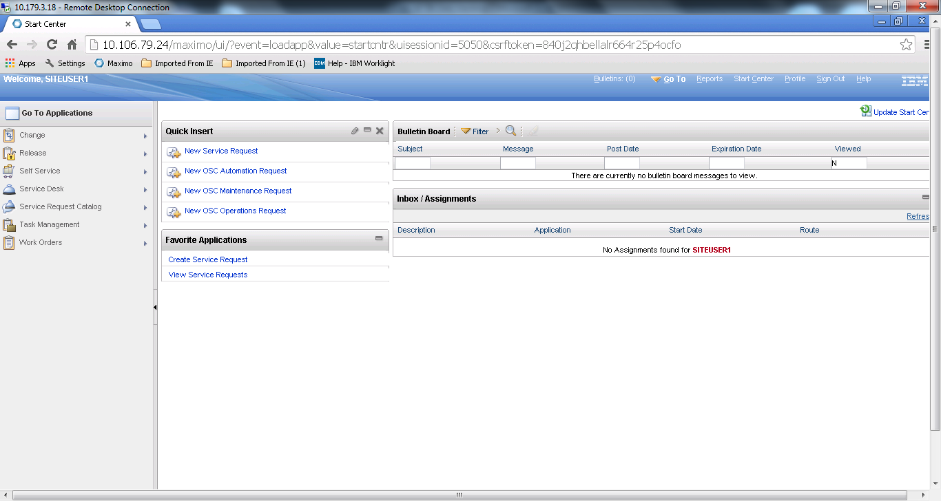
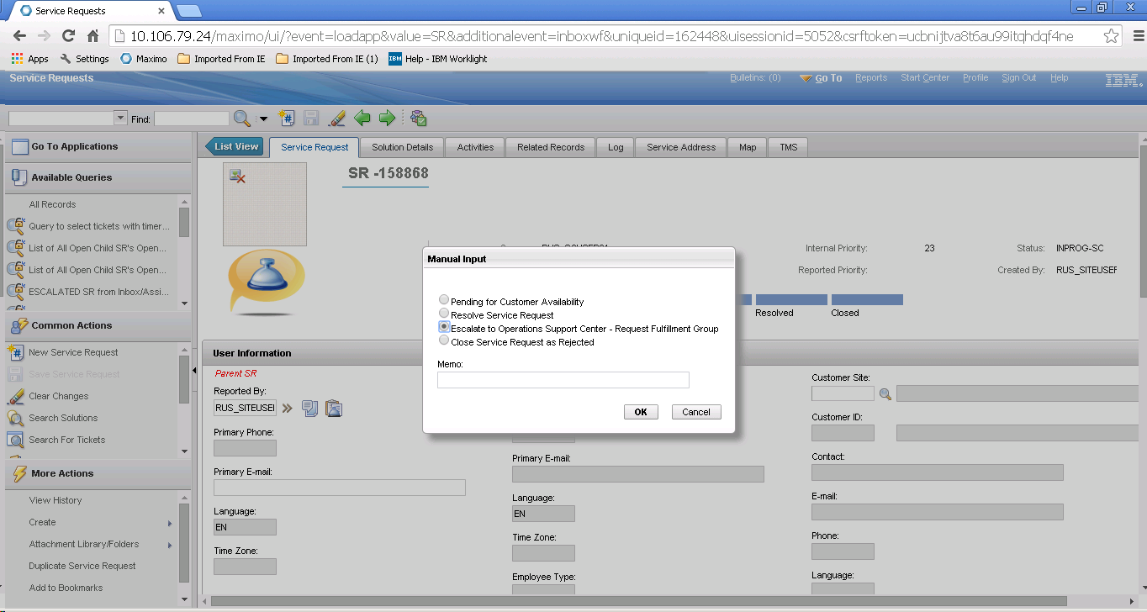
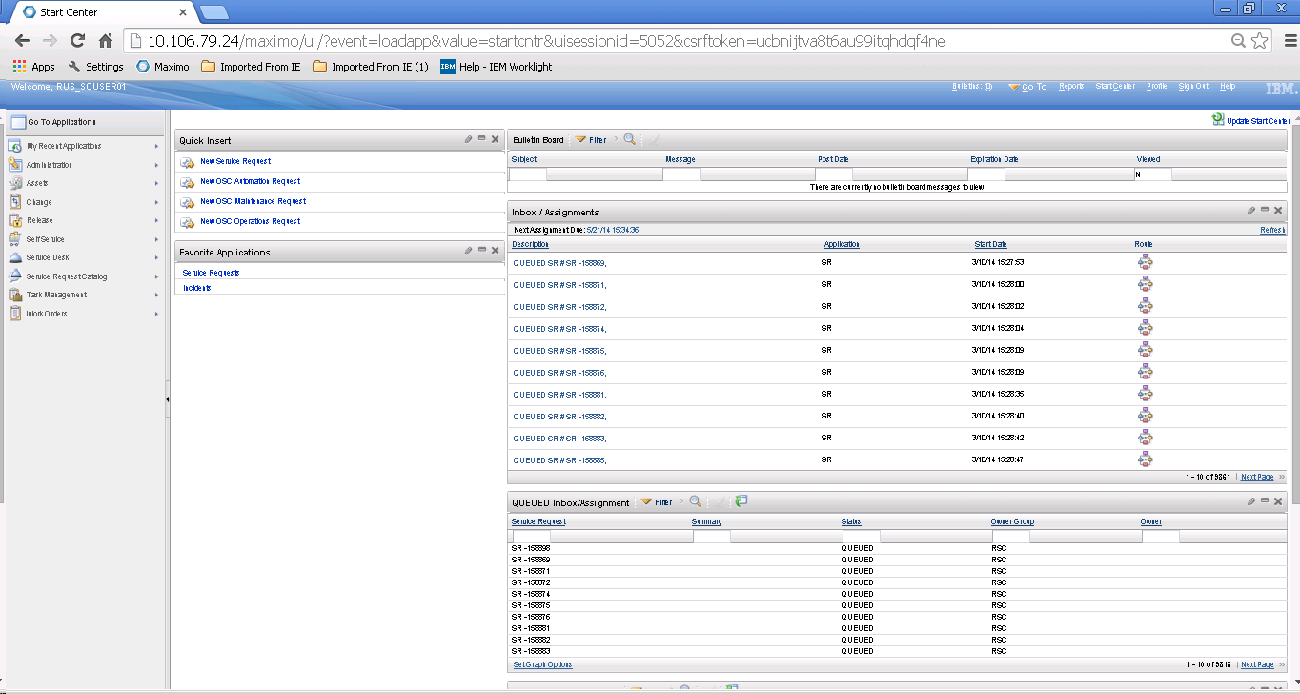
The “front end / basic” Visibility
Action by user
Landing Page

Slide 7
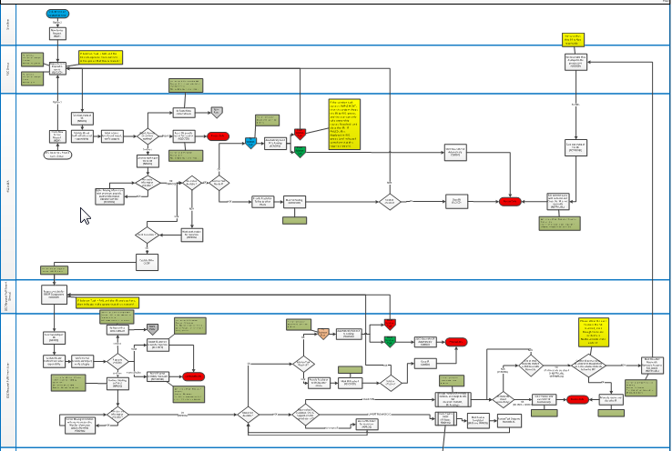
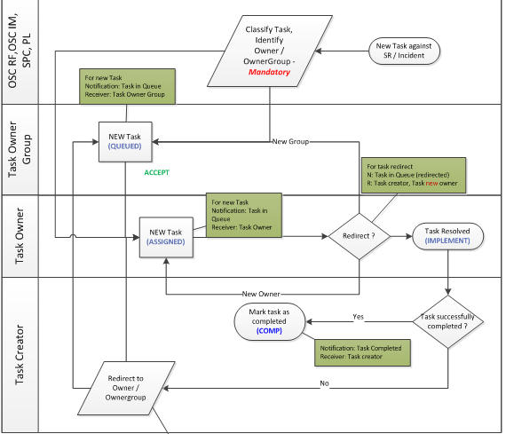
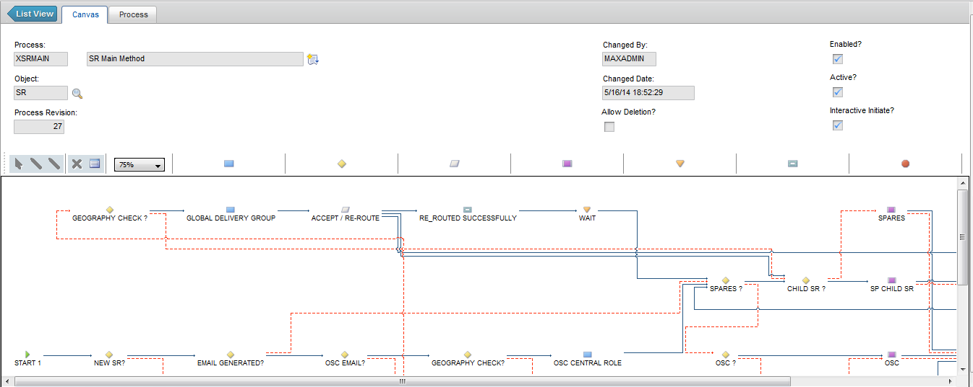
Workflow Automation / implementation involves…

Slide 8
“Typical” PT
Results as reported
“Standard” outcomes and report
Notes:
Section breaker slide:
Used for a section heading. You may add a sub heading not exceeding one line also here
Section heading – Arial, bold, 34 font size, should not exceed beyond 1 line
Sub Head – Arial, normal, 20 font size, should not exceed beyond 1 line

Slide 9
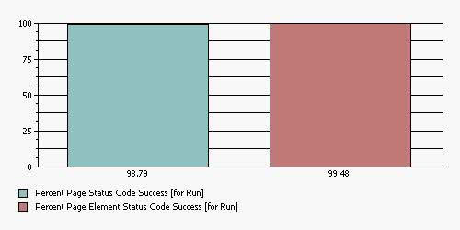
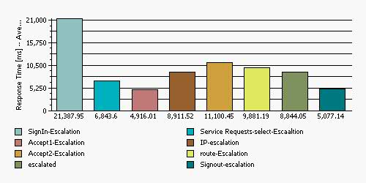
Summary of Test Results
Overall successful transactions: Pages – 98.79%
Total Users | 30
Elapsed Time [H:M:S] | 0:31:06
200 Codes | 44,645
500 Codes | 236
Total Page Hits | 1,323
Average Response Time For All Pages | 9.76
Maximum Response Time For All Pages | 318.13
Page Performance - Average Page Response Time for Run
Pages marked below have high avg RTs – Dev team to tune them….
 | Response Time -- Average | Attempts -- Count
SignIn-Escalation | 21.39 | 182
Service Requests-select-Escaaltion | 6.84 | 176
Accept1-Escalation | 4.91 | 165
IP-escalation | 8.91 | 167
Accept2-Escalation | 11.1 | 163
route-Escalation | 9.88 | 162
escalated | 8.84 | 158
Signout-escalation | 5.07 | 155

Slide 10
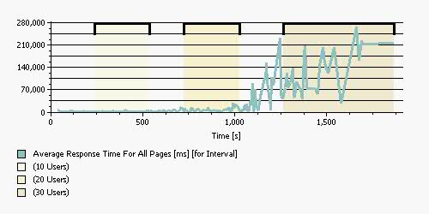
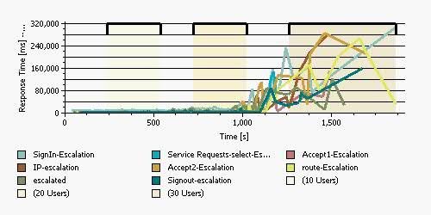
Summary: Response times: Spiked post xx users – yy mins
Avg Page Response times across all pages vs. Time
(as shown by the Load testing tool: RPT in this case)
Average Page Response Times through the test
(as shown by the Load testing tool: RPT in this case)
RTs of all pages would have been low but avgs became high because of the spike seen…
Why spikes….

Slide 11
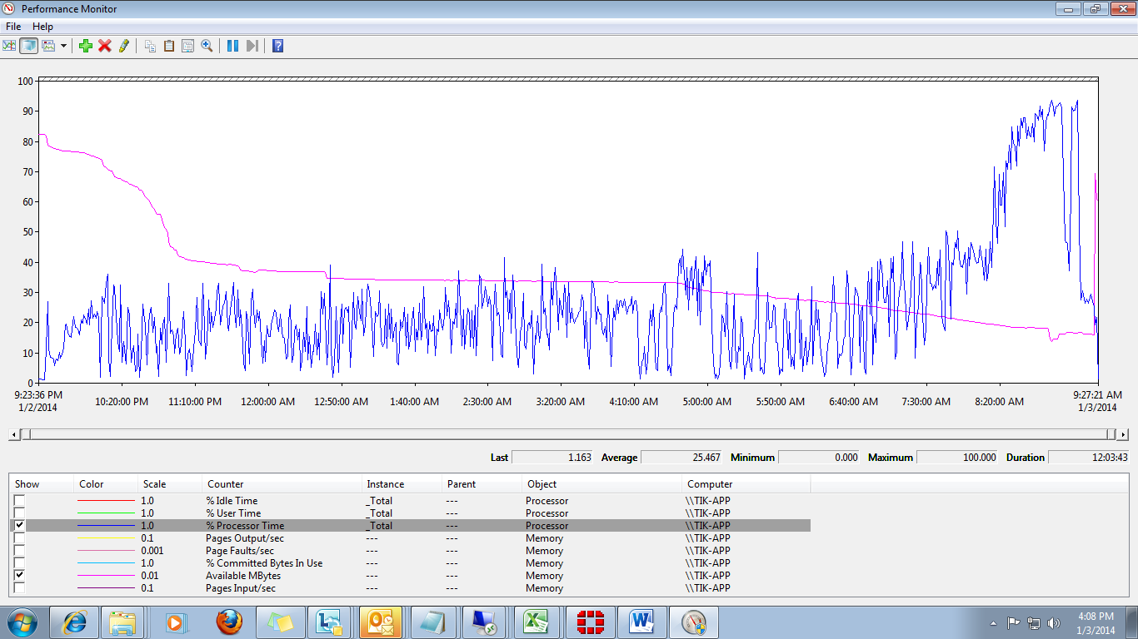
Summary: Utilizations : CPU, Avl Memory on server
 | CPU | Mem
App | Avg 28% - Intermittent spikes to 98% | 7.7 GB before test 7.1 avl during test settling down to 7.3 GB post test
DB | Avg 56 % - Intermittent spikes to 100% | 6.5 GB before test 5.7 GB avl during test settling down to 6.2 Gb post test

Slide 12



Typical - Standard PT / NFT
“Application” is regarded to be “black box”
Visibility and “reporting” of what is seen in (i) PT tool – the “front end” metrics and (ii) underlying hardware - server utilizations….
PT tool
Front end / e2e metrics
I provide the test outcomes, not an authority on the application…
Application under Test
I am simply consuming “out of the box” functionality…
Infrastructure - Hardware
Utilization metrics
PT engineer
Developer
“Knowledge” of what goes on “inside” the “Application” is “unknown” – outside purview
In case of “top or bottom” showing “abnormal/poor” behavior “pointed out” by testing:
  Dev / design team is expected to “figure out” what could be possibly happening…

Slide 13


Moving beyond “Typical”
“Application” no more a “black box” w.r.t. non-functional behavior
Visibility and understanding of what is happening “inside” the product and how it affect (i) the “front end” metrics and (ii) underlying hardware - server utilizations….
Front end performance
How the internal non-functional behavior affects the front end and downstream components… Cause – effect...
What are “individual” grey areas ? What possible changes in configuration – settings can yield better outcomes…
Application under Test
PT engineer
Developer
Infrastructure
Utilization
Correlation – diagnosis – configuration tuning…
Scalability, throughput, design – deployment options…

Slide 14

Typical Vs Enhanced visibility: NF Footprint of application
Behind the curtain – within the platform
Concurrently Active Users on Application
Active vusers
Distribution of active users across application instances in cluster
HTTP hits on web server and responses to them
Page hits
Application level “hits” – work content for app tier
SQLs required to be executed by the application: variety & volumes
Response times
Time for execution of SQLs: total, by type
Efficiency of DB and App to handle requests
Distribution & responses across cluster instances
CPU – Mem utils
Number of processes required to execute app level hits
Efficiency of process to manage volumes & times
Memory usage by individual instance of application

Slide 15
Application level parameters: Load on application - SQL transactions
Workflow automation essentially involves “lot of allocations” by the applications
Heavy DB interactions to “create”, “assign”, “classify”, “stage”,….
App level “activity” translates into lot of SQLs…
All types of DB interactions – select, update, insets…
60 vusers doing around 1 journey or flow per minute results in around 7000 application level hits
Hits are fairly served by the 2 instances of application – each serving between 3K to 4K

Slide 16
Application level parameters: Cluster instances in use – load balancing
2 application clusters configured on app server
Load balancing scheme set to: Random
(Round robin had resulted in very skewed distribution)
Fairly equal distribution –throughout the test duration intervals
Note that since the application works through sessions – the load distribution is based on “sticky sessions”
Once a user is “routed” to a particular cluster (by the load balancer) – all his (further) transactions mandatorily go to the same cluster – so distribution can not be exact

Slide 17
Application level parameters: Actual Users on application
Users connected to system
The test was executed with 60 vusers and the application showed at the max 88 concurrent active users connected on the system
Indicates user sessions stay (slightly) longer after the vuser logs out – need to check the corresponding settings
Cluster wise user distribution
The users seem to be evenly distributed across the 2 clusters
Random load balancing scheme
Again 30+ users - sessions on each cluster – so “longer” sessions on BOTH clusters

Slide 18
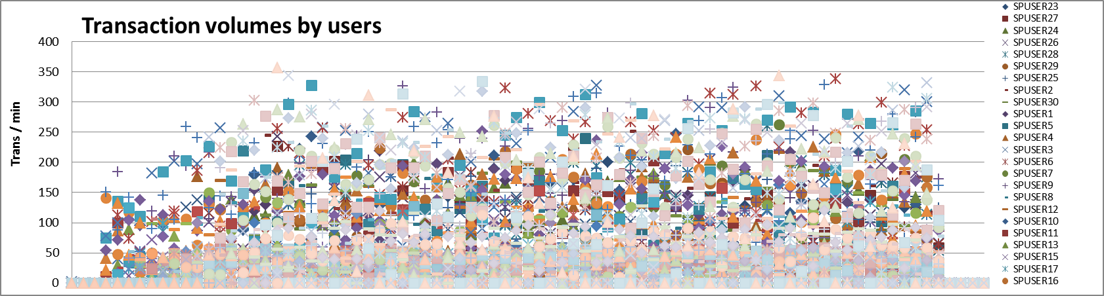
Application level parameters: Transaction volumes by users
Application level transactions associated with each user – all users actively doing transaction throughout the test duration
With the rate of 1 iteration per minute – all users are pumping load at slow rate
Each user (while doing his flows) results in around (up to) 100-250 application level activities
The volumes will be different for diff users depending on the nature of business process that user is doing: the avg hits per min range from 168 per minute with total of 11k hits to 6 per min with total of 500 hits for the different flows and users doing those flows

Slide 19
Downstream level parameters: Application impacting params
Chart shows total time for execution of ALL queries every minute
These queries are directly associated with the response time for end users and hence the application performance is a direct function on these
For the given load – the total execution time is around 30-40 sec
The chart on bottom shows that the total execution time increases linearly with the application level hits – this is normal, a non-linear rise is indicative of constraints - bottlenecks

Slide 20
Application level parameters: SQL transactions and processes
Summary of SQL queries – Brief SQL corresponds to the query skeleton
Chart shows number of DISTINCT brief SQLs in action and number of DISTINCT tables-objects (main table associated with the SQL)
Indicates around 110 tables/objects in action for ALL the flows and around 180 types of queries being executed across ALL activities
Application works on threads – processes to carry out the app level transactions – mainly the SQLs – the count of processes in use is shown
10 processes in dormant / idle state – reaching to 30-40 and peaking at 50’s

Slide 21
Application level parameters: Efficiency of Application- Processes
Each individual process is capable of executing multiple SQLs
As number of front end transactions increases – it results in growth on SQLs – which in turn require processes to execute and thus count of processes increases
Application requires ≈ 5 processes per 1000 app level hits per minute
Each process can execute ≈ 200 SQLs per minute summing to ≈ 1 sec execution time

Slide 22
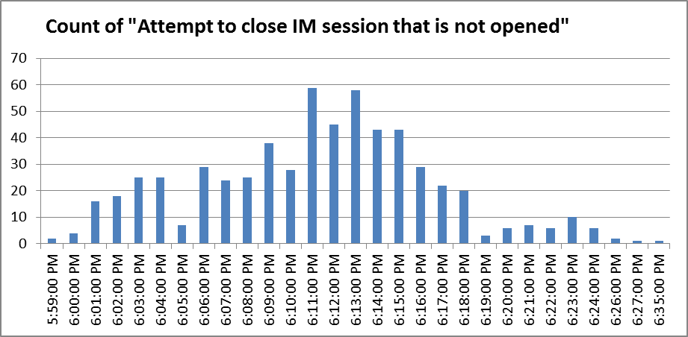
Application level insight: Errors, suspicious activities…
2 instances of: App logs (TIK-App_MaxClust2_maximo.log.2): Session Id updated by another user…
  13 Mar 2014 18:10:15:799 [ERROR] [MaxClust2] [] BMXAA8229W - Record MAXSESSION : MAXSESSIONUID=190,967 has been updated by another user. Your changes have not been saved. Refresh the record and try again.
  psdi.util.MXRowUpdateException: BMXAA8229W - Record MAXSESSION : MAXSESSIONUID=190,967
Errors throughout the test: “Attempt to close IM session that is not opened” followed by “IM session handler closed. Reason: There is no WebClientSession correlated to this HttpSession”
  Any issue with pacing with same user id being used for logging by
  the next vuser before the previous user logs out with the same id ??
Initial count around 20 per minute – rising to 60 per minute and
then gradually coming down…
Cluster 2 instance ran out of memory: at 18:29:58 and 200 msec
13 Mar 2014 18:29:58:200 [ERROR] [MaxClust2] [] Java heap space
java.lang.OutOfMemoryError
App logs (TIK-App_MaxClust2_maximo.log); NullPointerException?
13 Mar 2014 18:29:58:191 [ERROR] [MaxClust2] [] java.lang.NullPointerException
13 Mar 2014 18:29:58:191 [ERROR] [MaxClust2] [] java.lang.NullPointerException
13 Mar 2014 18:29:58:201 [ERROR] [MaxClust2] [] java.lang.NullPointerException
13 Mar 2014 18:29:58:200 [ERROR] [MaxClust2] [] Java heap space java.lang.OutOfMemoryError: Java heap space at ?
13 Mar 2014 18:34:46:661 [ERROR] [MaxClust2] [] Java heap space java.lang.OutOfMemoryError: Java heap space
13 Mar 2014 18:35:48:887 [ERROR] [MaxClust2] [] java.lang.NullPointerException
13 Mar 2014 18:36:02:373 [ERROR] [MaxClust2] [] java.lang.NullPointerException
13 Mar 2014 18:36:02:382 [ERROR] [MaxClust2] [] java.lang.NullPointerException

Slide 23
Uncover Non-functional “footprint” of business usage: optimal performance – deployment based on next level of visibility
End use of application in view of fulfilling the business processes through different stages and actors: results in this (NF) impact on “application”
Business entities – Actors (across geographies)
Business processes
1000 app hits: require 5 Processes for RT under 3 sec
1 process: 200 app hits or SQLs per minute
1 process: 1 sec of total SQL execution through 200 SQLs per minute
DB: 1 CPU per 2500-3000 hits/min:
16 Gb RAM
App: 1 CPU per 5000-6000 hits/min
App:
2 CPUs + 4 Gb RAM per instance in cluster

Slide 24
Thank you
Dr Abhijit S Ranjekar
Senior Consultant
Abhijit.ranjekar@wipro.com
Notes:
Thank you slide with the customer logo:
Should have only the details shown here. Logo placement cannot be changed. Wipro logo to appear on the left as per our corporate guidelines.
Thank you– font size 30, Arial Bold
Name & Designation – font size 18, Arial normal, not to exceed beyond 2 lines
Your/contact email id – font size 18, Arial normal

